Slide 1
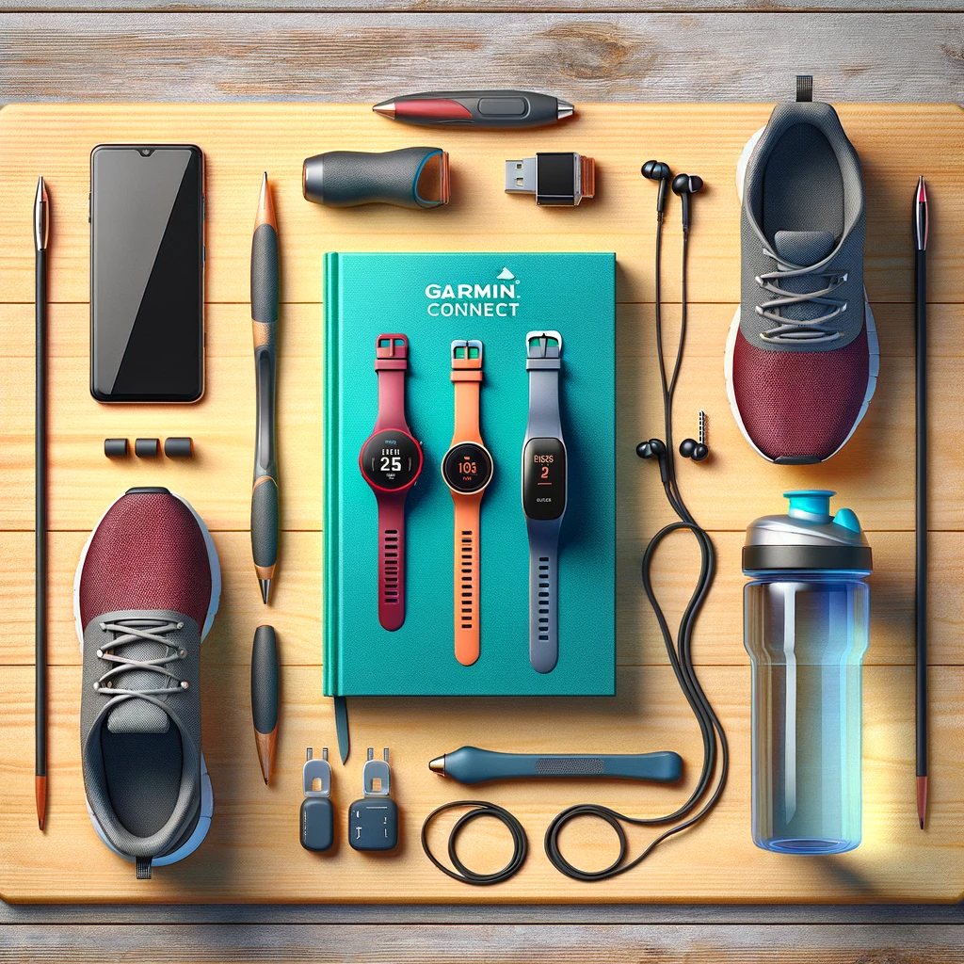

SUM
AYSHA
NIDA
MOHAMMAD

Slide 2
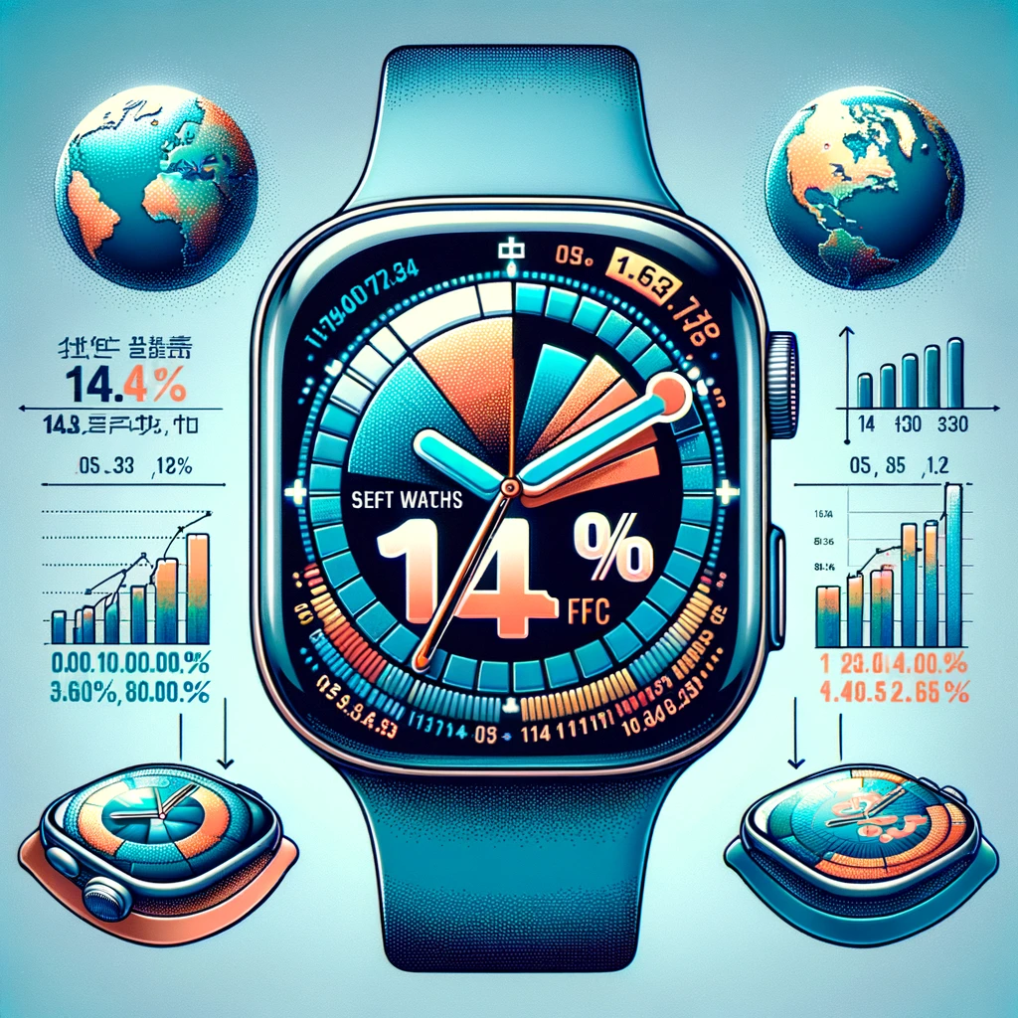
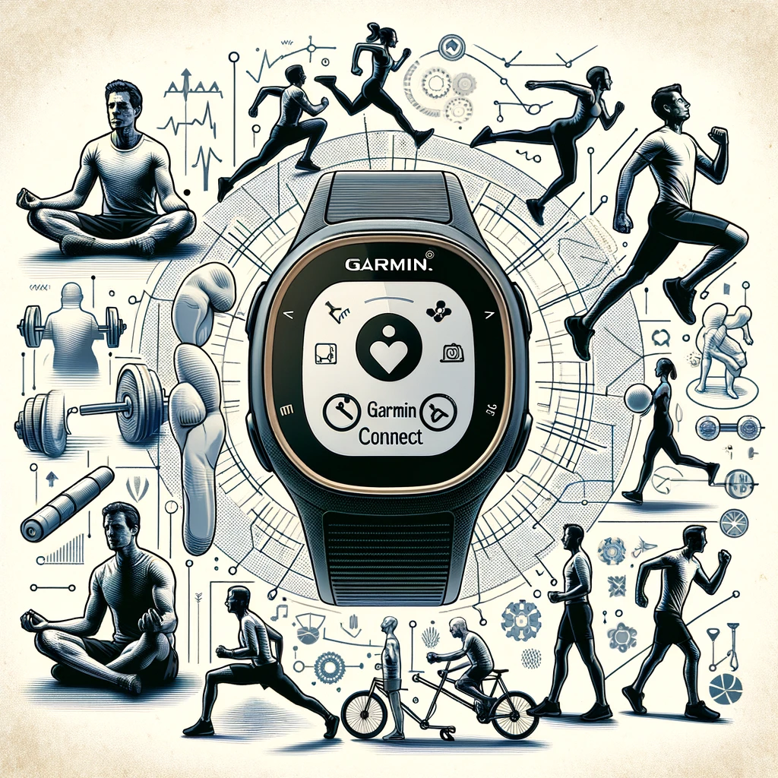
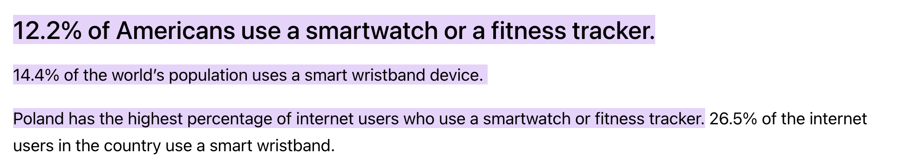
This is the story of a man and his one true love…
Source: Dataportal
… his fitness tracker.
Notes:
This is the story of a story of a man and his one true love … his Garmin Connect.
But he is not alone – according to research by Dataportal in 2023, 14.4% of the world’s population used a smart wristband device - that’s

Slide 3
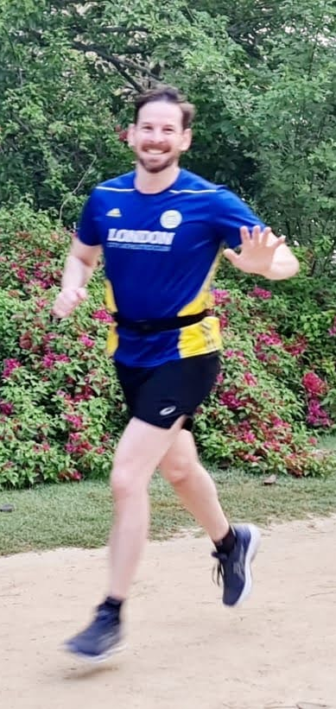
PROJECT OVERVIEW
Ethical Considerations
Commitment to Privacy and Ethics in Data
Informed Consent
Data provided voluntarily for non-commercial use.
Anonymity
Analysis ensuring individual privacy and confidentiality.
Ethical Use
Data handling aligns with high ethical values, prioritizing user trust and integrity.
Future Outlook
Building a Foundation for Data-Driven Fitness Analysis
Expandable Model
Ready to integrate additional data following ethical guidelines.
Research and Development
Aiding individuals and researchers in understanding physical activity.
Data Protection
Ongoing commitment to robust privacy and data security practices.
Transforming Fitness Data into Actionable Insights
Goal
Develop a data engineering solution to analyse fitness patterns from Garmin wearable devices.
Data Source
Anonymized data from a Garmin watches, used with consent.
Purpose
To structure rich datasets into a database, enabling visualization and tracking of health and fitness.
Privacy First
Strict adherence to privacy, with no personally identifiable information (PII) used.
Scalability
Designed for expansion, adding more data under strict ethical standards.
Notes:
Sum - Basic motivation for the project and ethical considerations

Slide 4
Notes:
Nida – Describe raw data and transformation process

Slide 5
Notes:
Aysha – Talk through ERD and database creation

Slide 6
Notes:
Aysha – Talk through ERD and database creation

Slide 7
Notes:
Mohammad – Basic flask setup + showcase

Slide 8
Notes:
QR to repo + Any questions

